Slide 1
Online Shopper
Purchase Prediction
Zul Fauzi Abas

Slide 2
The Challenge in E-Commerce
Understanding the vast, varied behaviors of online shoppers is a major challenge.
Predicting these behaviors enhances consumer engagement, making interactions more personalized and effective.
Huseynov, F., & Özkan Yıldırım, S. (2019). Online consumer typologies and their shopping behaviors in B2C
e-commerce platforms. Sage Open, 9(2), 2158244019854639.

Slide 3
Objective & Goal
Build machine learning model that can
Predict Purchases from Browsing Behavior
with Accuracy > 80%.

Slide 4
Why?
Patterns & insight from model will enables data-driven decisions:
Personalize Product Recommendations
Optimize Marketing Campaigns
Improve Customer Engagement
Thus...
Increased Revenue & Customer Satisfaction

Slide 5
How?
Shopper
Platform
Predictive Model
Y
Input:
Duration
Scroll rate
Click rate
Predictive Model
Up sales
Discount
Testimony
Sales!
N
Predictive Model
API Integration
Plugin

Slide 6
Modeling Approach

Slide 7
EDA
Identify pattern, outliers, skewness & imbalance.
Pre-Processing
Address EDA issue
Modeling
From Kaggle
Focus browsing behavior features
Fit, predict, evaluate with several ML model
Optimize the best model
Dataset
Tuning

Slide 8
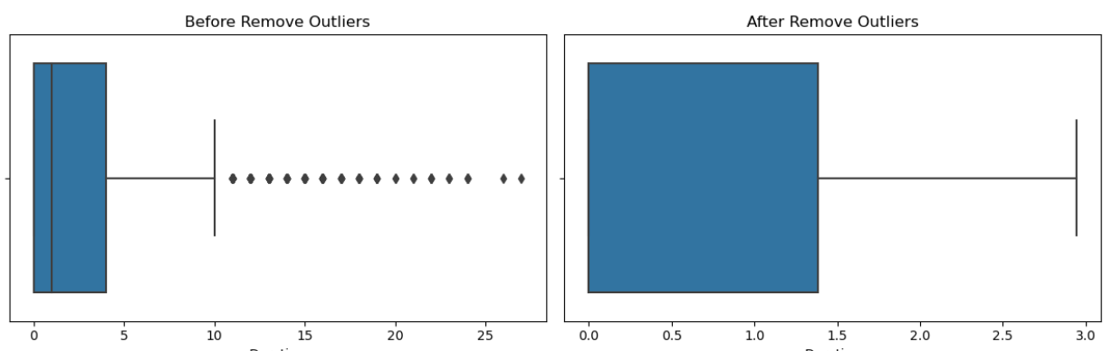
Prepare the Data...
Outliers; Detect & remove using IQR method
Figure 1. 'Administrative' feature; before and after removing outliers

Slide 9
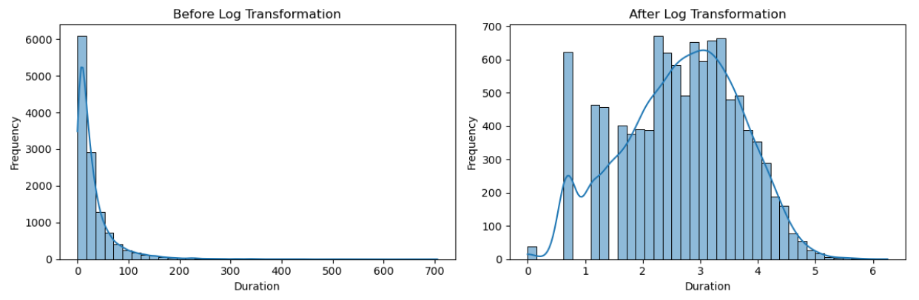
For Skewness; Applied log transformation to features
Figure 2. 'Product Related' feature; before and after log transformation

Slide 10
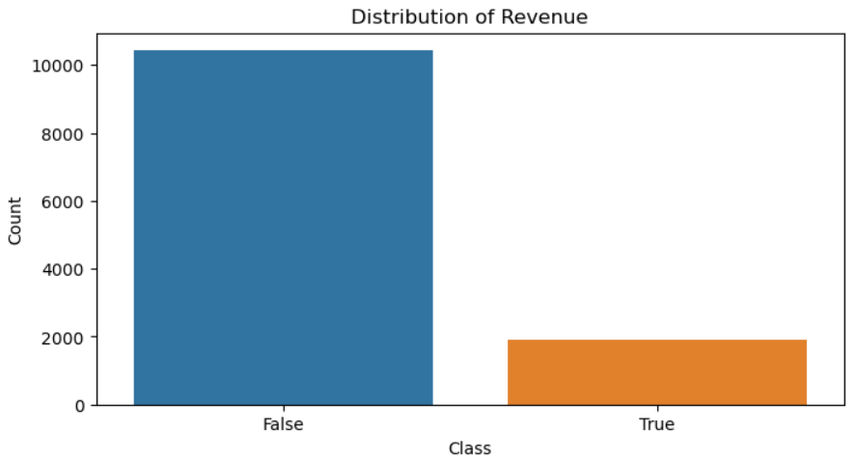
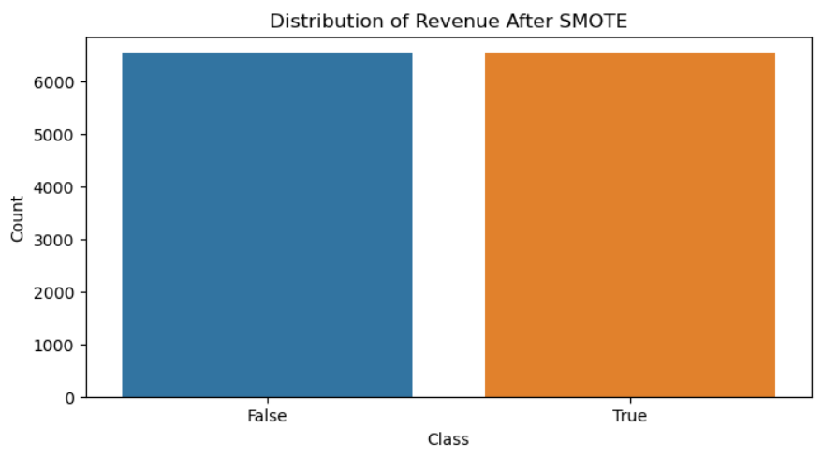
For Class Imbalance; Corrected using SMOTE
Figure 3. 'Revenue' feature; before and after applying SMOTE

Slide 11
Modeling Strategy
Models tested on training data:
Logistic Regression
KNN
Decision Trees
Random Forests.
Accuracy chosen as the performance metric.
Selection for tuning is based on classification performance.

Slide 12
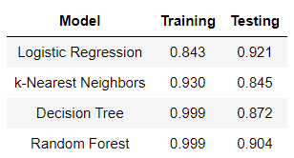
Model Performance
Logistic Regression achieved the best balance, avoiding overfitting.
Table 1. Accuracy of Model on Training
& Testing Set

Slide 13
Tuning and Results
Post-tuning, accuracy improved to 84.3%, exceeding our goal.

Slide 14
Conclusions
The predictive model accuracy exceed goal expectation.
Next steps:
Refining the model by including other feature
Develop API & Plugin for model.
Complete analysis link:
https://github.com/mzfauzi89/Capstone-Project

Slide 15
Thank you

